Slide 1
Resistant Hypertension: Definition, Prevalence and Clinical Implications
Mohammmadreza Taban
Internist-cardiologist , Fellowship of Heart failure & Transplantation
Tabriz university of medical science

Slide 2
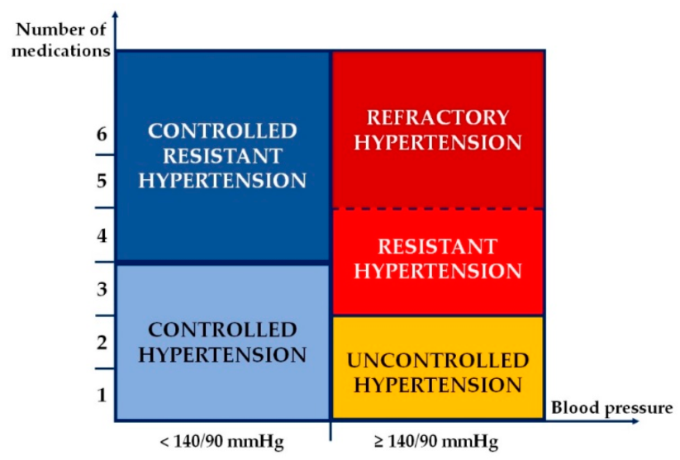
Definitions
Uncontrolled Hypertension
Blood pressures not at goal
General goal < 140/<90
Specific populations < 130/<80
CKD, ASCVD, DM and CHF
Causes
Previously undiagnosed Hypertension
Medication Non-adherence
Resistant Hypertension

Slide 3
Definitions
Resistant Hypertension
Failure to achieve goal BP despite adherence to 3 antihypertensive drug regimen.
One of the agents is a diuretic.
Drugs are optimally dosed.
Controlled BP with 4 or more antihypertensive drugs.
2018 ESH/ESC Guidelines:
treatment strategy fails to lower office SBP and DBP values to <140 mmHg and/or <90 mmHg, and is
confirmed by ABPM or HBPM
in patients whose adherence to therapy has been confirmed

Slide 4
Definitions
Pharmaceutics 2021, 13, 714. https://doi.org/10.3390/pharmaceutics13050714

Slide 5
Resistant Hypertension-Associated Phenotypes
2017 ACC/AHA guideline introduced two new concepts:
1- Controlled R-HTN ➔ at least four antihypertensive medications and achieving an adequate office BP control.
2- Refractory R-HTN (rfR-HTN)➔ elevated office BP values while on treatment with five or more antihypertensive drugs
( including a long-acting thiazide-type diuretic, such as indapamide or chlorthalidone, or a mineralocorticoid receptor antagonist (MRA), such as spironolactone .)
3- masked uncontrolled R-HTN➔ receiving four or more antihypertensive medications and achieving an adequate office BP control, but with elevated out-of-office BP
screening of masked uncontrolled HTN should be performed in all patients with controlled R-HTN , due to higher CV risk and thus needing a more aggressive therapeutic strategy

Slide 6
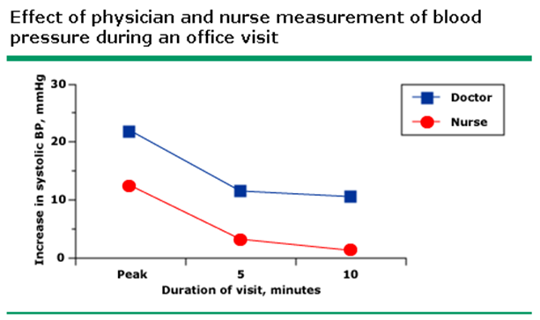
confirmed inadequate control of BP (by ABPM or HBPM)
Pseudo-Resistant Hypertension
Inaccurate Measurement
patient has been seated quietly in a chair with back supported for five minutes.
cuffs are too small relative to the arm circumference
White coat effect.
Marked brachial artery calcification
Inadequate treatment regimen.
Poor adherence to antihypertensive therapy.:
Multiple medications.
Frequent changes.
Side effects.
Cost !!!

Slide 7
Pathophysiology of Resistant Hypertension
R-HTN is broadly attributed to two underlying processes:
renin-angiotensin-aldosterone system
endothelial dysfunction, sympathetic activation and oxidative stress ➔ inflammation, calcification and fibrosis
in R-HTN due to several non-genomic pro-inflammatory effects that can maintain a pharmacologically resistant state
Sympathetic nervous system activation
impaired parasympathetic tone and increased sympathetic activation ➔ early stages of HTN + development of target organ damage.
mechanisms of sympathetic activation ➔cardiopulmonary reflex dysfunction, chemoreceptor stimulation, baroreflex dysfunction, central factors, insulin and leptin➔ vascular remodeling + endothelial dysfunction + arterial stiffness in hypertensive state
in patients with R-HTN➔ significant activation of renal sympathetic system
sympathetic activation is more pronounced in patients with R-HTN
Role of Genetics: ?
it is probably caused by both common and rare gene variants.

Slide 8
Incidence of R-HTN & rfR-HTN
The true prevalence of R-HTN ➔ is likely to be <10% of treated patients.
The prevalence of rfR-HTN:
Spanish Registry ( 70,997 treated patients) ➔ R-HTN (16.9%) and rfR-HTN (7.9% of R-HTN and 1.4% of the entire treated group)
in the REGARD Study ➔ rfR-HTN = 0.5%
Compared with R-HTN, patients with rfR-HTN were
younger,
had a longer duration of HTN,
a higher prevalence of obesity,
diabetes mellitus,
dyslipidemia,
chronic kidney disease
target organ damage
previous history of CV events

Slide 9
Clinical Implications of R-HTN
Higher incidence
Cardiovascular events, particularly stroke
More LVH, carotid intimal thickening
Progressive kidney disease
CHF
Death

Slide 10
Cardiovascular Risk in Resistant HTN
5 years follow-up➔ Events: fatal/nonfatal MI, revascularization (CAD or PVD), CHF, stroke and ESRD
Event-rate per 100 patient-yrs
True Responders, n = 340, rate= 0.87
Masked HTN, n = 126, rate= 2.42
False Resistant, n = 146, rate= 1.2
True Resistant , n = 130, rate= 4.1

Slide 11
Diagnostic approach of resistant hypertension

Slide 12
Diagnostic approach of resistant hypertension
The Road to Better Management in Resistant Hypertension—Diagnostic and Therapeutic Insights. Pharmaceutics 2021

Slide 13
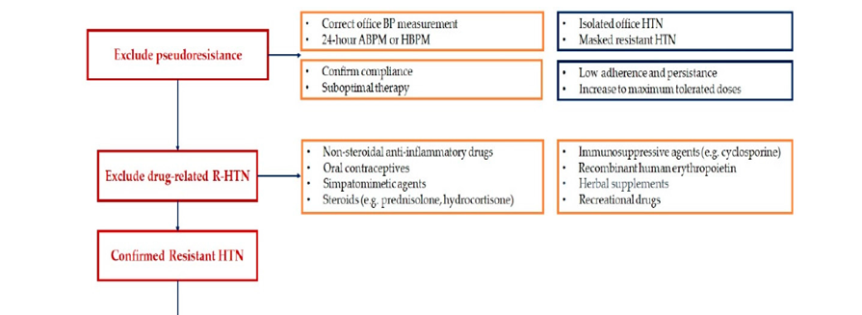
Diagnostic approach of resistant hypertension
The Road to Better Management in Resistant Hypertension—Diagnostic and Therapeutic Insights. Pharmaceutics 2021

Slide 14
Diagnostic approach to resistant hypertension
(1) The history:
lifestyle characteristics,
alcohol and dietary sodium intake,
interfering drugs or substances,
sleep history.
(2) A physical examination,
presence of HMOD (hypertension mediated organ damage)
signs of secondary hypertension.
(3) The nature and dosing of the antihypertensive treatment.
(4) Confirmation of treatment resistance by out-of-office BP measurement ( ABPM or HBPM).
(5) Laboratory tests :
electrolyte abnormalities (hypokalaemia),
associated risk factors (diabetes),
organ damage (advance renal dysfunction),
secondary hypertension: primary aldosteronism , atherosclerotic renal artery stenosis ( in older patients or with CKD)
(6) Confirmation of adherence to BP-lowering therapy.

Slide 15
Confirm Treatment Resistance: ABPM and, if not available, HBPM
White-coat uncontrolled HTN
Masked uncontrolled HTN
Sustained uncontrolled HTN
Exclude Pseudo-resistance
Exclude Drug-Related Resistant Hypertension
Exclude Secondary Causes of Hypertension

Slide 16
Lifestyle factors.
Dietary salt consumption:
Assessment of 24 hrs. UNa excretion ( goal <100 meq/24 hrs).
Alcohol consumption:
Alcohol should be limited to 1 ounce/day in RH patients.
Obesity or large gains in weight
Intake of vasopressor or sodium-retaining substances , OCP
Sleep

Slide 17
Drug-related causes of Resistant Hypertension
NSAIDs
Steroids
Sympathomimetics
Decongestants
Weight Loss Meds
Cocaine
Oral Contraceptives
Erythropoeitin
Cyclosporine
Licorice
Stimulants
Methylphenidate
Amphetamine
Modanifil
Calcineurin Inhibitors
Herbal Meds
Ephedra
Ma huang
Tricyclic antidepressants

Slide 18
Secondary causes of Resistant Hypertension
primary aldosteronism
renal artery stenosis ( in older patients or with CKD)
Obstructive Sleep Apnea (OSA) is prevalent!!
Obesity
CKD
Pheocromocytoma
Cushing’s syndrome

Slide 20
Therapeutic Approach of Resistant Hypertension

Slide 21
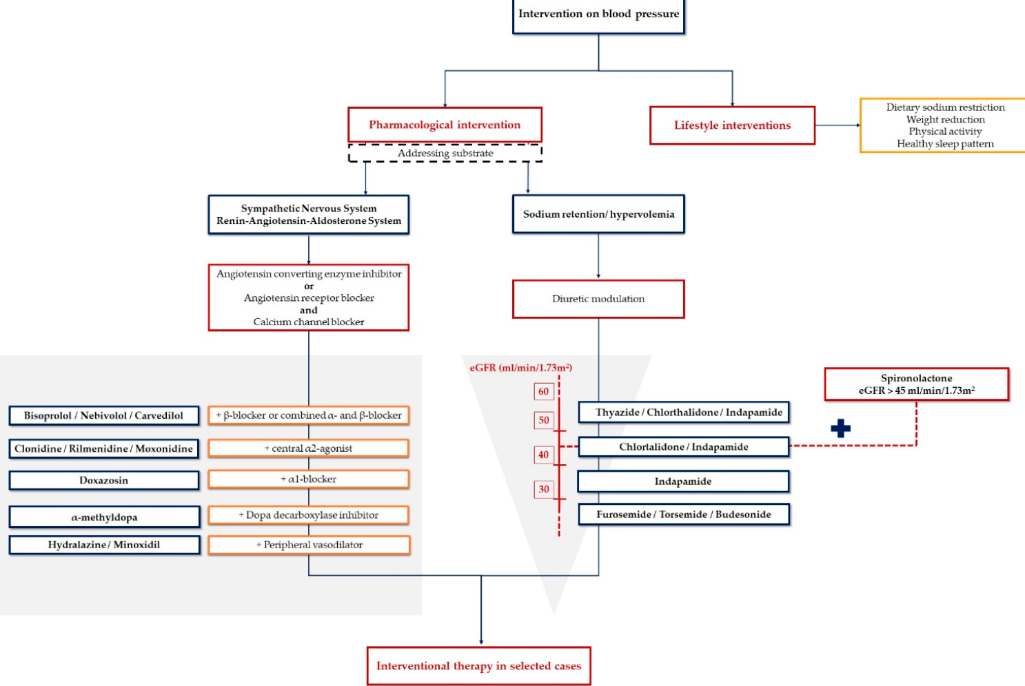
Therapeutic approach of resistant hypertension.
The Road to Better Management in Resistant Hypertension—Diagnostic and Therapeutic Insights. Pharmaceutics 2021

Slide 22
Nonpharmacological Strategies:
Lifestyle changes
Weight Reduction
Na Restriction
The DASH Diet
Physical Activity
Other Risk Factors
Psychological Counselling
Discontinuation of interfering substances,

Slide 23
Pharmacological Strategies
The optimal drug treatment of resistant hypertension
has been poorly studied.
Optimizing the Three-Drug Regimen
Optimizing the Diuretic Treatment
Adding a Mineralocorticoid Receptor Antagonist
Adding Beta-Blocker or Alfa+beta-Blocker
Adding alfa1-Blocker or a Peripheral Vasodilator

Slide 24
Treatment of resistant hypertension
Diuretic:
The most effective strategy seems to be additional diuretic treatment to decrease volume overload.
with the restriction of salt intake, particularly in patients with CKD.
increasing the dose of the existing diuretic
or by switching to a more potent thiazide-like diuretic (chlorthalidone or indapamide).
A loop diuretic should replace thiazides/thiazide-like diuretics if the eGFR is <30 mL/min.

Slide 25
Treatment of resistant hypertension
Although resistant hypertension may show a BP reduction if the existing diuretic dose is further increased ➔ most patients require the administration of additional drugs.
fourth-line treatment ?
should involve a blockade of aldosterone = MRAs
Spironolactone: up to 50 mg/day.
Antiandrogenic side effects ➔ breast tenderness or gynaecomastia (in 6%), impotence in men, and menstrual irregularities in women.
Patients with an eGFR >_45 mL/min and a plasma potassium <4.5 mmol/L.
eplerenone (50 - 100 mg/day). ➔ (due to androgen-like side effects of spironolactone )
Amiloride (10 - 20 mg/day) ➔ effective as spironolactone 25–50 mg daily) in reducing BP (PATHWAY-2 Study)

Slide 26
Treatment of resistant hypertension
as alternatives to spironolactone.
B- blocker ➔ Bisoprolol : (5 - 10 mg/day)
Alpha-1 blocker➔ Doxazosin : (1 mg ➔4 – 8 -16 mg/day)
Neither was as effective as spironolactone, but they did reduce BP significantly vs. placebo
Thus, bisoprolol and doxazosin have an evidence base for the treatment of resistant hypertension ➔ when spironolactone is contraindicated or not tolerated.
Direct vasodilators: such as hydralazine or minoxidil:
are infrequently used because they may cause severe fluid retention and tachycardia.
New BP-lowering drugs: (nitric oxide donors, vasopressin antagonists, aldosterone synthase inhibitors, neutral endopeptidase inhibitors, and endothelin antagonists) are all under investigation.

Slide 27
Device-based hypertension treatment

Slide 28
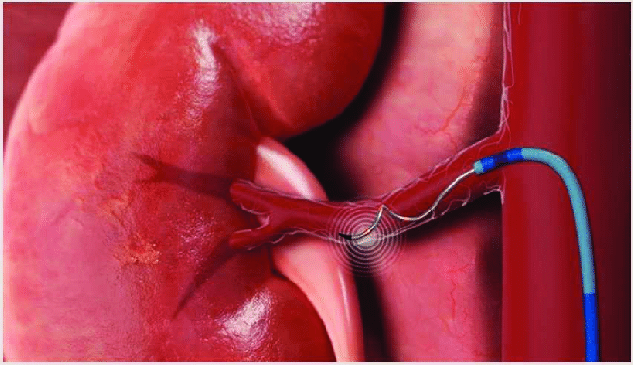
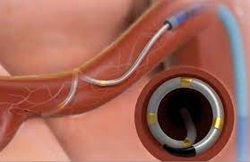
Renal denervation
Sympathetic nervous system ➔renal vascular resistance + renin release, + sodium reabsorption
Catheter-based radiofrequency, ultrasound, or perivascular injection of neurotoxic agents such as alcohol has been introduced as a minimally invasive treatment option
clinical evidence ➔ is conflicting.

Slide 29
The purpose ➔ ablate the sympathetic nerves (by radiofrequency or ultrasound) in patients with R-HTN taking 4–5 antihypertensive drugs by three
studies called SYMPLICITY (Catheter-based renal sympathetic denervation for resistant hypertension: a multicenter safety and proof-of-principle cohort study).
It was first used in
SYMPLICITY HTN-1 (a human feasibility trial )
SYMPLICITY HTN-2 study (larger randomized prospective ) ➔a reduction in office BP and a good safety profile when using this device.

Slide 30
SYMPLICITY HTN-3 (The first sham-controlled randomized clinical trial) ➔ little to no effect on BP in patients with severe R-HTN
Possible explanations are incomplete nerve ablation due to poorly designed catheter electrodes
inexperienced operators,
non-adherence to the multidrug pharmacological regimen
not including ABPM in the efficacy analysis.
DENER-HTN (the Renal Denervation for Hypertension ) ➔ a statistically significant reduction in daytime ambulatory systolic BP (–5.9 mmHg) in hypertensive patients on a three-drug regimen randomized to renal sympathetic denervation, when compared to patients taking four antihypertensive medications without renal denervation.

Slide 31
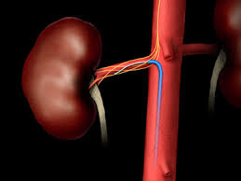
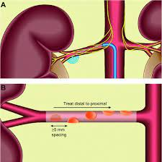
Two RCTs with a sham procedure ➔ failed to document the superiority of renal denervation compared with the sham procedure in reducing BP, but did confirm the safety of the procedure.
The PRAGUE-15 study ➔ similar effects between renal denervation and optimized pharmacotherapy (mainly by adding spironolactone) + the latter was associated with more side effects and high discontinuation rates.
Beyond resistant hypertension, interim data in the first 80 patients treated with renal denervation but with no background antihypertensive therapy showed a modest effect of renal denervation vs. sham control on 24 h ambulatory BP .

Slide 32
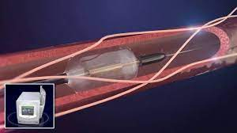
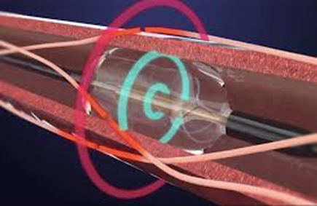
Recently, SPYRAL-OFF MED Pivotal trial (catheters have been re-designed to allow complete circumferential renal nerve ablation.)
sham-controlled, randomized trial that uses this type of catheter and evaluates renal sympathetic denervation independently of antihypertensive drugs.
➔ significant BP reduction (–4.7 mmHg in 24-h ambulatory BP and –6.6 mmHg in office BP) after 3 months of followup
Radiofrequency from renal sympathetic denervation can be replaced with ultrasound, as new research demonstrated—Paradise Renal Denervation System, ReCor Medical. This technique also showed a reduction of BP in its own proof-of-concept trial

Slide 33
complicated by
(i) the complex pathophysiology of hypertension,
(ii) the lack of clinically applicable measures of sympathetic activity,
(iii) the absence of predictors of the long-term BP response following renal denervation,
(iv) the absence of reliable markers of procedural success to immediately
establish whether denervation has been achieved.
The evidence➔ isolated systolic HTN (increased aortic stiffness) ➔ limited response to renal denervation and baroreceptor stimulation
Major uncertainties remain

Slide 35
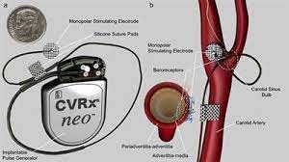
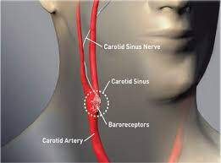
Carotid baroreceptor stimulation: 1- pacemaker = (Rheos and BAROSTIM NEO systems) 2- stent: (MobiusHD).
leads to a reduction of sympathetic signals to the vessels, heart an kidneys ➔ reduction of BP.

Slide 36
implantable pulse generator
RCT with the first generation of an implantable pulse generator showed sustained BP-lowering efficacy (and sympathetic nervous system inhibition), but with some concerns about procedural and longer term safety.
A second-generation unilateral device has been developed to improve safety and sustained efficacy. BP at 12 months post-implantation was similar, with a better safety profile for the second-generation device.
Rheos Pivotal Trial ➔ no superiority of baroreceptor activation therapy for reducing BP compared to medical therapy after a six-months follow-up,
more than half achieved a systolic BP less than 140 mmHg

Slide 37
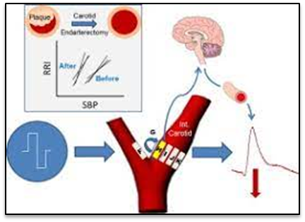
stent: (MobiusHD).
A dedicated stent-like device designed to stretch the carotid bulb and increase baroreflex sensitivity.
lowere coste and simple intervention.
Shown evidence of BP-lowering efficacy of this new approach,
but data from ongoing RCTs are needed to definitively understand its longer-termefficacy and safety.

Slide 38
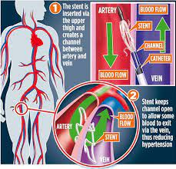
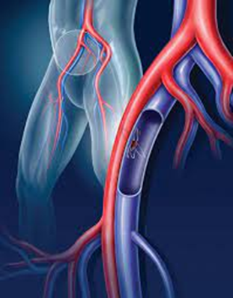
Creation of an arterio-venous fistula
The central iliac arterio-venous anastomosis (4 mm) ➔ unloading the arterial vascular bed into the venous system.
ROX CONTROL HTN trial (a stent-like nitinol device) ➔ resistant HTN ➔ RCT= At 6 months, office and ambulatory BP were significantly reduced in the coupler group compared with the control group.
safety aspects ➔ Ipsilateral venous stenosis = occurred in 29% of patients.
No reports of RV- failure or high-output cardiac failure after device implantation over the short-term, but longer follow-up is clearly needed.

Slide 39
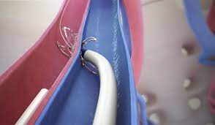
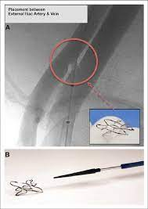
ROX Coupler Device

Slide 40
Other devices
Surgical resection of the carotid body
Endovascular carotid body modification by ultrasound-guided ablation
The carotid body is innervated by nerve fibres from the vagus nerve through the cervical ganglion and the carotid sinus nerve.
Stimulation of the carotid body drives sympathetic tone, resulting in an increase in BP and minute ventilation.
reductions in BP and sympathetic over-activity in patients with heart failure.
In summary,
device-based therapy for hypertension is a fast moving field.
Further sham-controlled studies are needed before device-based therapies can be recommended for the routine treatment of hypertension outside of the framework of clinical trials.

Slide 41
Looking into the Future
New therapeutic agents:
neutral endopeptidase inhibitors: leading to a decrease of angiotensin-II
=> Omapatrilat vs. Enalapril (OCTAVE) trial ➔ antihypertensive effect was superior, more angioedema (2.17% versus 0.68%)
sacubitril/valsartan (ARB-blockers and neprilysin inhibitors) ➔promotes vasodilation, increases sodium excretion and displays antihypertrophic and antifibrotic properties ➔ reducing office and ambulatory central aortic and brachial pressures in elderly patients with systolic HTN and arterial stiffness
drugs prevents the degradation of natriuretic peptides into metabolites and promotes vasodilation, increases sodium excretion and displays antihypertrophic and antifibrotic properties

Slide 42
finerenone (BAY94-8662)=nonsteroidal mineralocorticoid receptor antagonists➔ Anti-fibrotic ,LVH , Pro- BNP , proteinuria, BUT not significantly influence BP (lower Hyperkalemia).
Aminopeptidase: a membrane-bound zinc metalloprotease ➔
Firibastat ➔
.

Slide 43
TAKE HOME MASSAGE
The importance of R-HTN is underscored by the associated risk of adverse outcomes compared with non-RHTN.
antihypertensive medication adherence is confirmed
out-of-office BP recordings exclude a white-coat effect,
contributing lifestyle issues,
detection of drugs interfering with antihypertensive medication effectiveness,
screening for secondary hypertension,
assessment of target organ damage.

Slide 44
use of long-acting thiazide-like diuretics (chlorthalidone or indapamide),
addition of a mineralocorticoid receptor antagonist (spironolactone or eplerenone)
and, if BP remains elevated, stepwise addition of antihypertensive drugs with complementary mechanisms of action to lower BP.
.

Slide 45
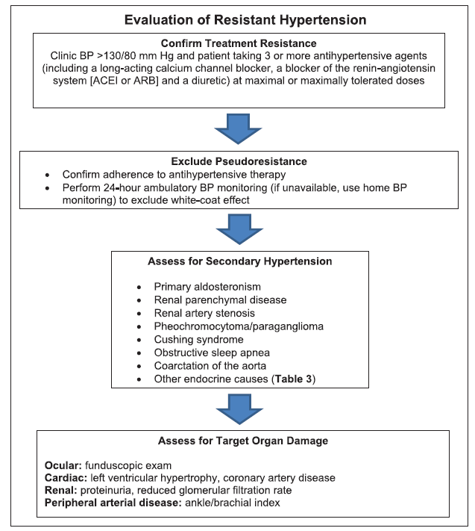

Slide 46
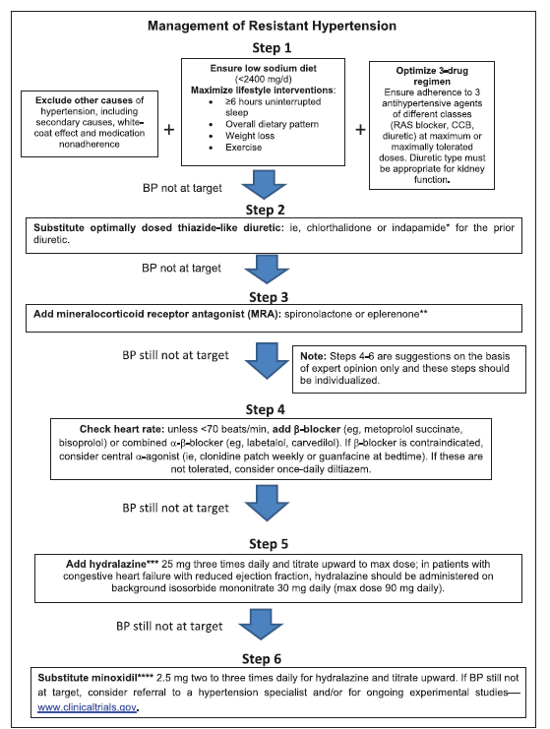

Slide 47
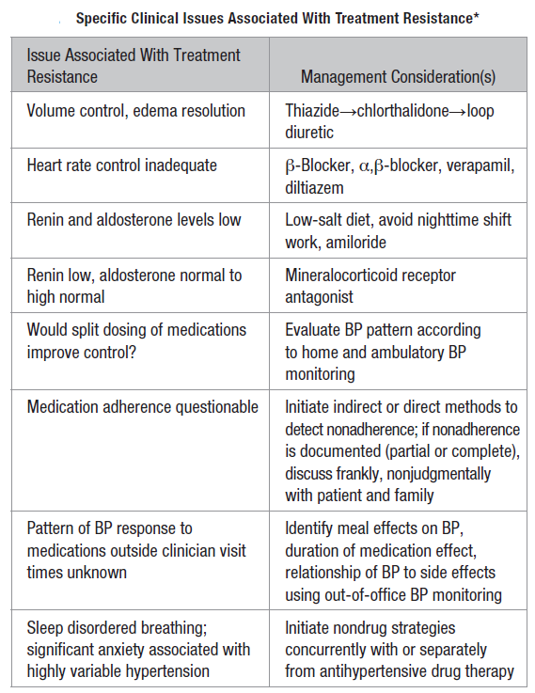

Slide 48
Conclusions
Resistant Hypertension is defined as uncontrolled HTN with BP > 140/90 on > 3 meds or controlled on > 4 meds
Exclude non-adherent patients
Prevalence ranges from 1.9 – 8.9% of HTN patients
Check for OSA in all patients and consider meds and other secondary causes
Note from a nephrologist
CONTROL VOLUME with DIURETICS
Increased CV event rates occur compared to controlled hypertension

Slide 49
با تشکر از حسن توجه شما

Slide 50
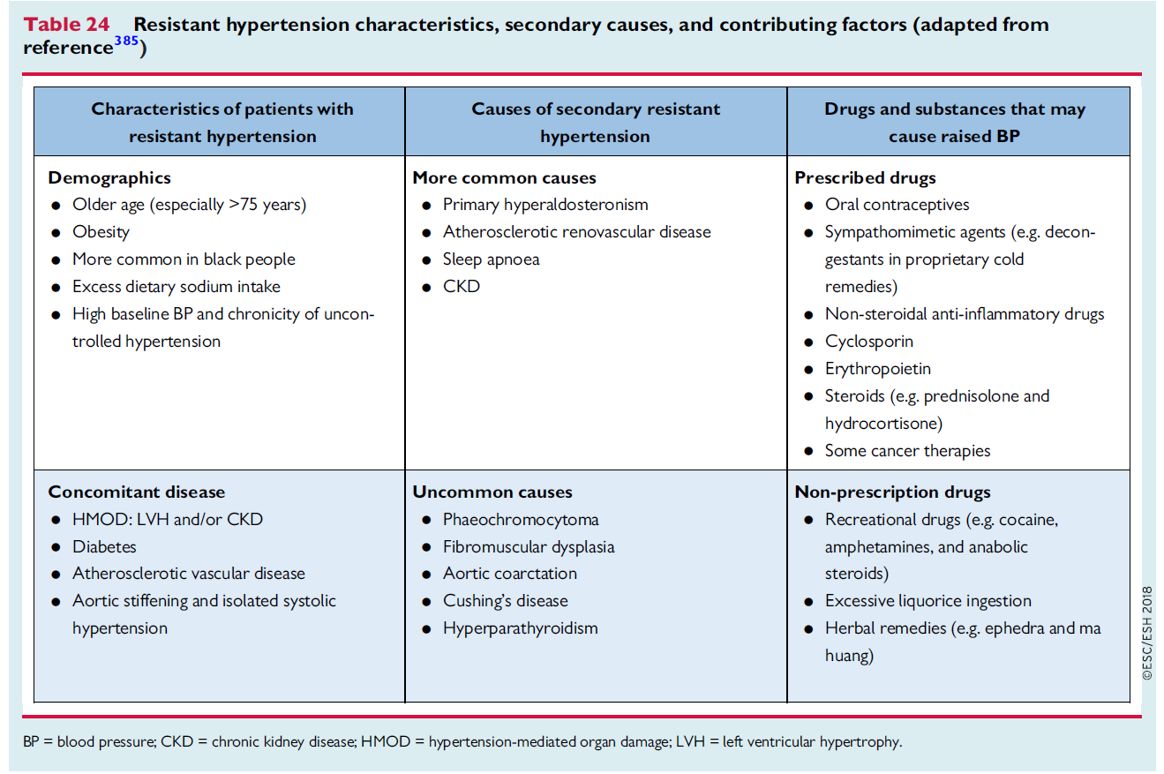

Slide 51
